Slide 1


DEPARTMENT OF INFORMATION TECHNOLOGY
Project name : FLOOD MONITORING AND EARLY WARNING
Team name : project_224785_Team_6
Team members :
LOKESH B(1133215205027) PREM KUMAR K(1133215205037)
YASHWANT KUMAR K(1133215205059)
VINOTH KUMAR R(1133215205037)

Slide 2
PROJECT
Building a Flood Monitoring And Early Warning using IoT:- Floods can be catastrophic, causing damage and danger to communities. A Flood Monitoring and Early Warning System is a straightforward project that aims to help protect lives and property. This system uses sensors to watch water levels and weather conditions in flood-prone areas, then sends alerts to warn people when a flood is likely to happen. By giving communities early notice, this project helps them prepare and stay safe when floods are on the way. It's a practical solution for reducing the impact of flooding and keeping people out of harm's way.

Slide 3
Requirements:
The Components that are required are:
1.Raspberry Pi (or any other IoT device)
2.Sensors (e.g., weather sensor, water level sensor)
3.IoT Platform (e.g., ThingSpeak for data visualization)
4.Actuators (e.g., LED lights, fans)
5.Relay module for controlling actuators
6.Internet connectivity(Wi-Fi,GSM,LoRa,etc)
7.power supply

Slide 4
PYTHON CODE
import RPi.GPIO as GPIO#define BLYNK_TEMPLATE_ID "TMPL3tobBFjj-"
#define BLYNK_TEMPLATE_NAME "IOT FLOOD MONITORING"
#define BLYNK_AUTH_TOKEN "gy2bzR-i-RbPW3oWOpAiDgr6sSVzIHVZ"
char auth[] = BLYNK_AUTH_TOKEN;
char ssid[] = "Wokwi-GUEST";
char pass[] = "";
#define BLYNK_PRINT Serial
#include <WiFi.h>
#include <WiFiClient.h>
#include <BlynkSimpleEsp32.h>
#include <ESP32Servo.h>

Slide 5
servo gate:
const int trigPin=2;//d2
const int echoPin=4;//d4
const int servoPin = 18;//d18
long duration;
int distance;
void setup() {
Serial.begin(9600);
Blynk.begin(auth, ssid, pass);
pinMode(trigPin, OUTPUT);
pinMode(echoPin, INPUT);
gate.attach(servoPin, 500, 2400);
}
void loop()
{
digitalWrite(trigPin, LOW);
delay(2);
digitalWrite(trigPin,HIGH);

Slide 6
delay(10);
digitalWrite(trigPin, LOW);
duration=pulseIn(echoPin,HIGH);
distance=duration*0.034/2;
Serial.println(distance);
Blynk.virtualWrite(V0,distance);
if(distance<50)
{
gate.write(90);
Blynk.virtualWrite(V1,"FLOOD DETECTED GATES OPENED");
}
else
{
gate.write(0);
Blynk.virtualWrite(V1,"SAFE CONDITIONS GATES CLOSED");
}
}

Slide 7
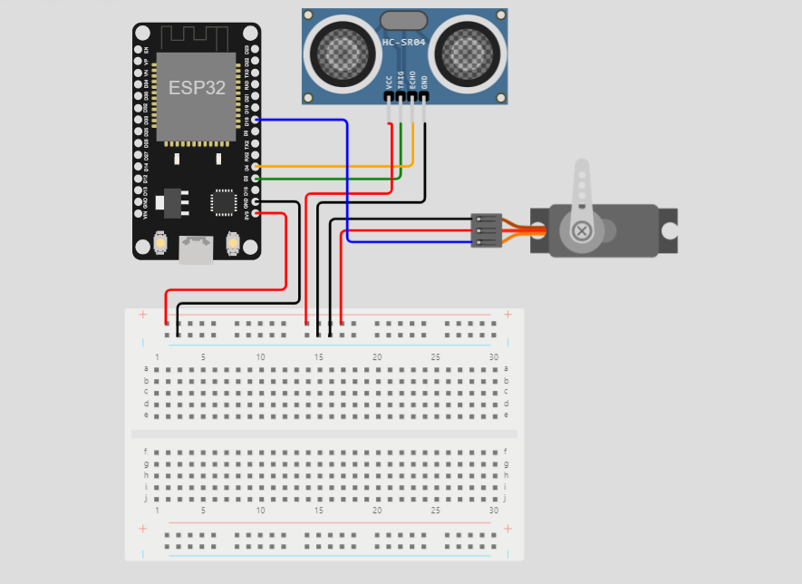
DIAGRAM:

Slide 8
CONCLUSION
In conclusion, the flood monitoring and early warning system project represents a crucial step towards mitigating the devastating impacts of floods. By integrating advanced technology, data collection, and real-time analysis, this project has the potential to save lives, protect property, and enhance disaster preparedness. The continuous monitoring of weather conditions, water levels, and flood-prone areas, coupled with timely alerts and community engagement, can significantly reduce the risk associated with flooding. However, the success of this project relies on effective collaboration between stakeholders, ongoing maintenance, and public awareness. As we move forward, it's imperative to prioritize funding, training, and infrastructure development to ensure the sustained effectiveness of the flood monitoring and early warning system.

Slide 9
THANK YOU

